Slide 1
Emirates
Osteopathic Conference

Slide 2
Association panel
Challenges and methods for Effecting change

Slide 3
Marika Jevbratt &
Gert-Jan Goede
President & Vice-President
EUROPEAN FEDERATION & FORUM FOR OSTEOPATHY

Slide 4
Merger
EFO + FORE = EFFO!
Notes:
EFO (European Federation of Osteopaths) and FORE (Forum for Osteopathic Regulation) sucessfully completed the merger and become one united European Organization
In Athens on the 9th of March 2018!

Slide 5
Merger Group
The Merger group consisted of:
EFO: Marika Jevbratt, Sylke Wagner Burkard, Jonathan Bailey Teyletche, Alex Boon
FORE: Gert-Jan Goede, Philippe Sterlingot, Hanna Tómasdóttir, Tim Walker
There were many people involved with the Merger work and we would like to thank them all.
Notes:
Thank you all involved! The Merger group met several times during the end of 2016, the whole of 2017 and the beginning of 2018! The meetings were very focused and concentrated. Most of the meetings were held in Brussels, one was held in Paris. Totally we met 7 times (6/7/16, 20/1/17, 24/4/17, 6/7/17, 25/9/17, 20/11/17, 15/1/18).
It was quite a hard task to merge the two organizations, we started as two opponents but working through our common tasks to merge we got closer to becoming one!
We discussed and agreed upon: a common strategic plan, the statutes for the New Organization (and here we need to thank Tim Walker and Sylke Wagner Buchard for their Hard work on the statutes). We discussed and agreed on a financial structure and plan as well as membership structure.

Slide 6
The story of a new name..
Notes:
We discussed and discarded various names for the New Organization –
And here when we seem to have got stuck, Dimitri Boulenger who was present at the meeting when we discussed finances and the name (EFO and EFFO’s treassurer suddenly just blurted out the Accronym EFFO – which broke the stalemate! We left the most difficult point of the discussion to the last meeting – ”the composition of the Board”

Slide 7
Board composition
Notes:
The big one was board composition! EFO had 5 Board members and FORE had 3 Board members. After lengthy discussions it was decided that the Board should have 7
members, in the new statutes it says that the board should have 4 - 7 members. At the last meeting - it was agreed that FORE should have 3 board positions and EFO 4!
EFO had a tough discussion to take within its own board.
But then something happend, Gert-Jan head of FORE informed the FORE members about the Merger and of course that the proposed composition of the Board!
The members did not approve and said we want to vote who is on the Board - open elections were held at the AGM of EFO and of EFFO in Athens!

Slide 8
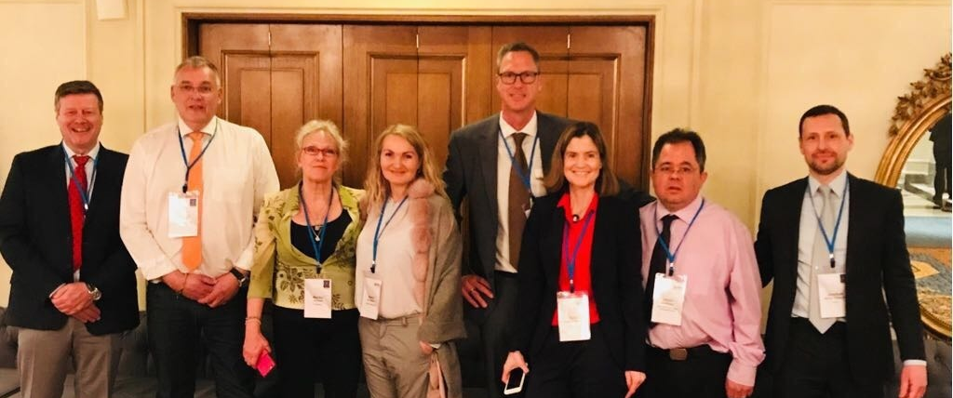
Presenting the Board of the EFFO
Notes:
Elected by the EFFO’s members in Athens, In order from left to right - Alex Boon (General Secretary), Gert-Jan Goede (Vice-President), Marika Jevbratt (President), Hanna Tommasdottir (Webdesign & PR),
Richard Weynem (Research – PROMS), Sylke Wagner Buchard (legal advisor) – this post is now taken by Maurice Cheng, Dimitri Boulenger (Treasurer), Jonathan Bailey Teyletche (Spokesman).

Slide 9
Background
Mission of the two organisations:
  EFO mission (purpose) was ‘to promote and harmonise the profession of osteopathy in all countries of the European Union’ and ‘to encourage public, medical and government recognition of the benefits that osteopathic practice can bring to public health and patient care’
  FORE mission was ‘to enhance the protection of patients in Europe by promoting the wider recognition and regulation of osteopaths and high standards of osteopathic treatment’
The missions have common elements, and were very similar:
  ’recognition’ (particularly ’regulation’)
  ‘harmonise’ standards (high/appropriate/safety)
  ‘Europe’ or ‘EU’
Notes:
Looking at the background and the mission of the 2 organisations – we can note that we have a similar mission, and of course it makes sense with one European organisation, looking after the
Member associations – doing the work that the members are requesting from us!

Slide 10
What do members need?
Recognition by
  governments
  fellow health professions
  the public
Recognition for
  primary contact health professionals
  complex interventions
  a distinctive health ‘brand’ (like doctor/nurse/surgeon/dentist)
An organisation which can act as the European voice of osteopathy
A membership model that is based on collaboration between members on
  Best practice in association management, research, stakeholder engagement, education
  Sharing challenges and solutions
  Defining and promoting minimum standards for competent osteopaths
  Defining and promoting advanced practice standards
Notes:
The members need a strong voice, and the possibility to work together with common goals – we should all be united, working togher, drawing from eachothers successes and mistakes!
The EFFO should be there for all these aspects as a cog in the wheel!

Slide 11
Vision: ‘the authoritative voice of osteopathy in Europe’
Strategic Aim of the EFFO Increase recognition and regulation across Europe
Support research, education, standards and professional practice
Build practical, effective and affordable organisation infrastructure
Notes:
I said it before ”the EFFO should be there to support research, education, standards and professional practice! The EFFO should be a force to be recond with, supporting and looking after its members in pursuing theirs and our common goals!

Slide 12
Thank you!
Proud member representatives of the New Organisation!
Notes:
It was a sunny day in Athens when it all happend! The merger of EFO and FORE – Now the new journey begins!

