Slide 1
Emirates Osteopathic Conference
OIA Educational Pillar
Chiara Arienti, MSc, DO, PhD(s)
General Secretary, Italian Register of Osteopaths

Slide 2
The effectiveness of Student 4 Best Evidence as a tool to improve Evidence-Based Practice competencies in undergraduate health professional students: a pilot study
Chiara Arienti, Emma Carter, Joel Pollet, Selena Ryan-Vig,
Francesca Gimigliano, Carlotte Kiekens, Stefano Negrini
IRCCS Don Gnocchi Foundation, Milan, Italy; Student 4 Best Evidence, Oxford, UK; Department of Clinical and Experimental Sciences, University of Brescia, Italy; Department of Mental and Physical Health and Preventive Medicine, University of Campania “Luigi Vanvitelli”, Napoli, Italy; KU Leuven, PRM, Leuven, Belgium; University Hospitals Leuven, Physical and Rehabilitation Medicine, Leuven, Belgium

Slide 3
Notes:
The idea started from here, from this study on the need to rethink the medical education in allied health professional curricula. So, we decided to create a EBP Laboratory inside the School of Physiotherapy of University of Brescia, Italy.

Slide 4
Aim
The aim of this study is to evaluate the effectiveness of an EBP laboratory, using S4BE as an educational tool, to teach EBP competence to undergraduate students of Physiotherapy.

Slide 5
Procedure
T0
Start EBP Laboratory
T1
after 24 training hours
Follow-up
after 3 months of clinical practice training
    Educational Program to develop EBP competencies: Student 4 Best Evidence
    Evidence-Based Practice Profile
    Questionnaire

Slide 6
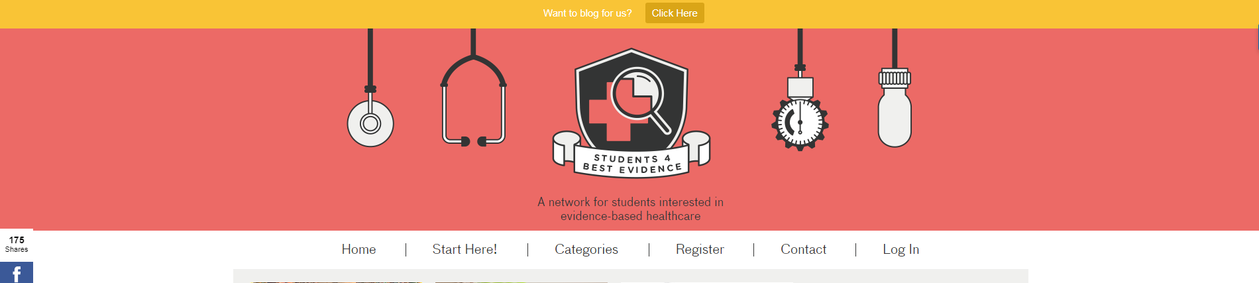
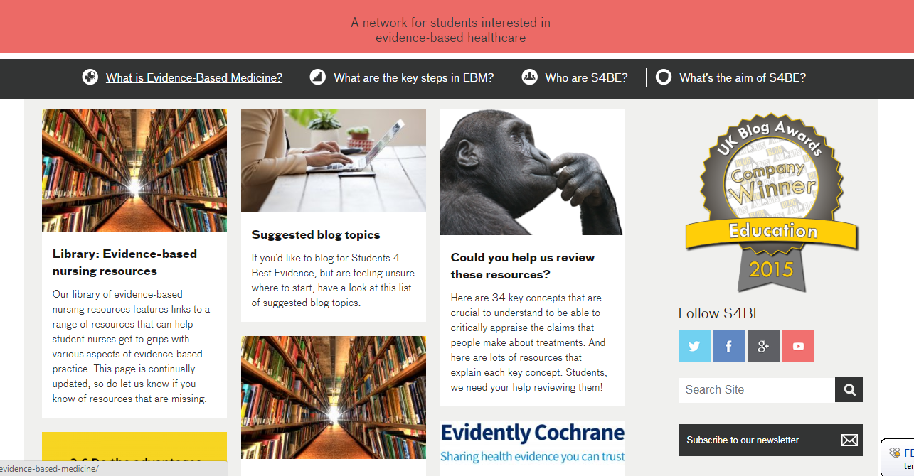
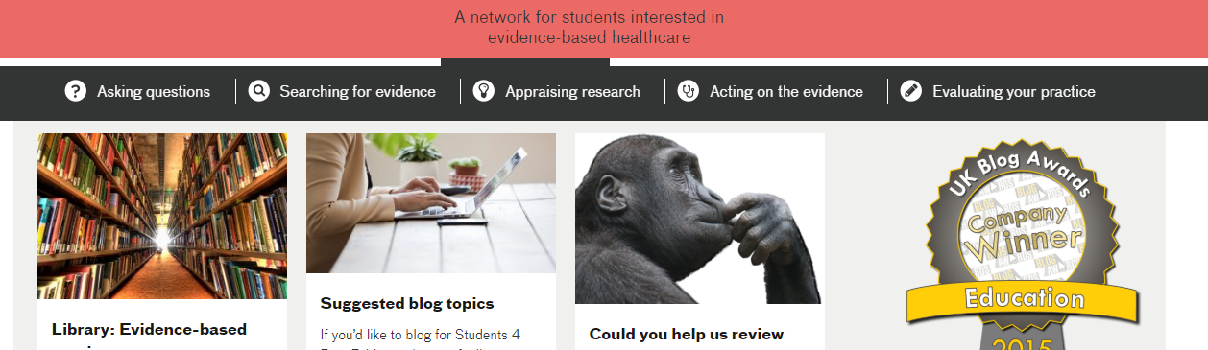
Educational Program
«Start Here»
«Categories»

Slide 7
Results
p=0.305
P<0.001
P=0.278
P<0.001
P<0.05

Slide 8
Discussion
Students kept the EBP competences during the time
        Relevance and confidence, two domains based on individual’s abilities with EBP skills, remained stable
        Sympathy, domain of relation between EBP competences and professional work is not changed
Significant improving of terminology and practice.
        Clinical practice training helps the use of EBP skills during every day clinical practice of the students.

Slide 9
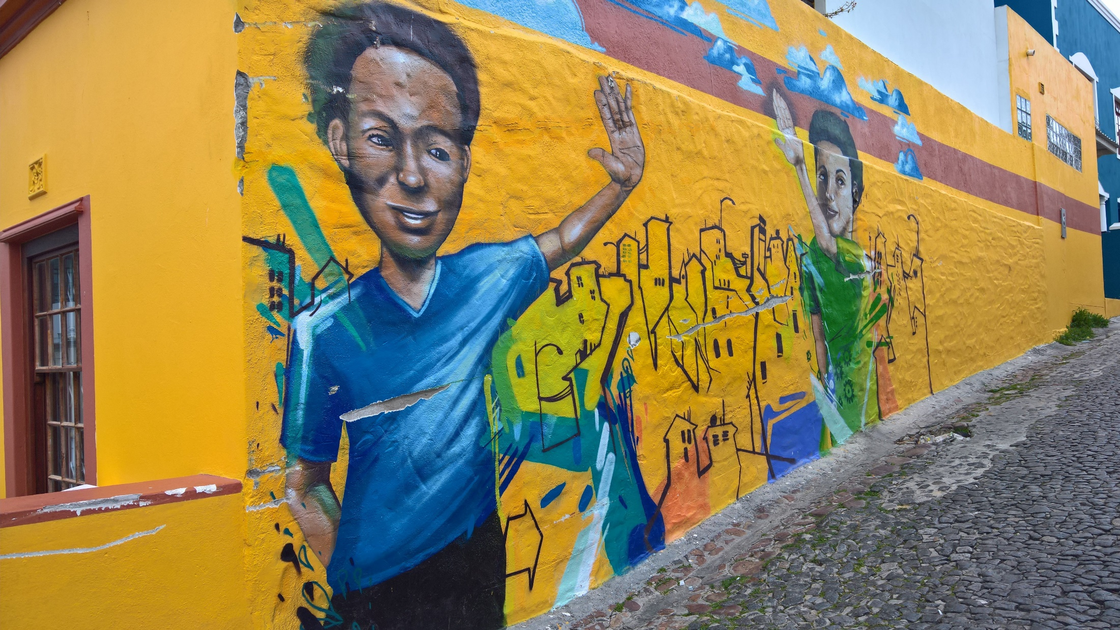
Thank you!
carienti@dongnocchi.it
www.rehabilitation.cochrane.org
@CochraneRehab
"If you want to go fast, go alone, if you want to go far, go together". African proverb

